Slide 1

Image Forgery Detection
Krishnam Sai Karthik (21BIT0390)
Vellore Institute of Technology
Date: 30th Jan, 2025

Slide 2
Abstract
Image Forgery Detection

Slide 3
Abstract
Digital images play a crucial role in media, law, research, and security.
Advances in image processing have increased image forgeries.
This project introduces a deep learning approach combining CNNs and ELA for forgery detection.
The model highlights inconsistencies in image compression to detect tampering.
A user-friendly interface is implemented using Streamlit.
Keywords: Digital Image Forgery, Convolutional Neural Networks (CNNs), Error Level Analysis (ELA), Image Tampering Detection, Pattern Recognition

Slide 4
INTRODUCTION

Slide 5
Introduction
Throughout the last few decades, there has been a sharp rise in the use of digital images. Virtually every facet of life now makes use of digital photos.
Many documents that must be filed online require images in the form of soft copies, and a lot of images are shared on social media every day.
Manipulated images spread misinformation and the victims of these activities may suffer financial loss as well as a loss of reputation
The technology of digital resource repositories is moving at a much faster rate due to social networking sites, making it very difficult to find the original source of the forgeries
A need exists for an automated, efficient, and reliable forgery detection system.

Slide 6
Problem Statement
Image manipulation is widely used for malicious activities.
Traditional forensic methods are insufficient for modern tampering techniques.
Requires a robust system that detects multiple types of forgeries efficiently.
Objectives
Develop a deep learning-based forgery detection system.
Use ELA to highlight tampering artifacts.
Provide an intuitive interface with Streamlit.
Ensure high detection accuracy.

Slide 7
Scope of the Project
Supports .jpg image format.
Uses CNNs combined with ELA for classification.
Suitable for forensic and journalistic applications.
Extendable for detecting different forgery techniques.
Proposed System
Step 1: Image Preprocessing (Recompression and ELA heatmap generation)
Step 2: Feature Extraction using CNNs
Step 3: Classification (Forged / Not Forged)
Step 4: Display results via Streamlit

Slide 8
Literature Survey
Comparative Study of Digital Image Forgery Detection Techniques: Explores passive detection methods that do not require special hardware but struggle with manipulations such as rotation and scaling.
Image Tampering Detection Using Genetic Algorithms: Utilizes feature extraction and genetic algorithms for high accuracy, though computationally expensive for large datasets.
Digital Image Forgery Detection Using Deep Learning: Employs CNNs for detecting complex image manipulations with high robustness, but requires significant computational power and large labeled datasets.
Enhancing Digital Image Forgery Detection Using Transfer Learning: Applies transfer learning for faster training and high accuracy, but is sensitive to post-processing effects like JPEG compression.

Slide 9
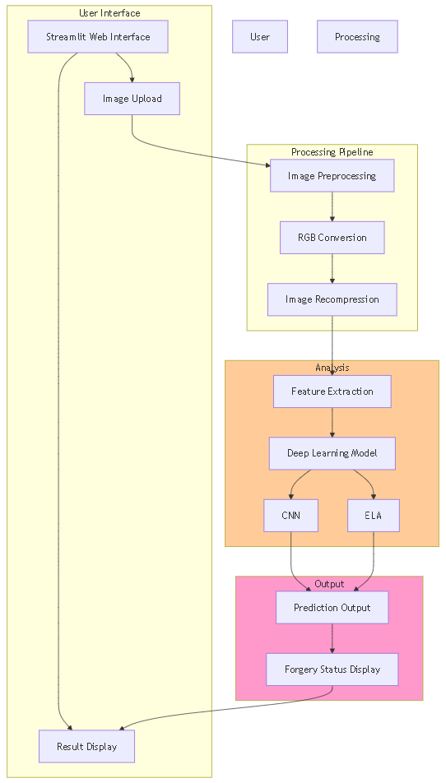
Proposed System Architecture
User Interface (Streamlit): Image Upload and Result Display
Image Preprocessing: RGB Conversion & ELA
Feature Extraction: CNN-based Feature Learning
Classification Model: CNN + ELA-based prediction
Prediction Output: Displays whether the image is forged or not

Slide 10
Thanks!

